Slide 1
Application of Artificial Intelligence Research in Biomedical Informatics - Informatics Bootcamp 2025
Da Ma
Assistant Professor
Center for Artificial Intelligence Research
Alzheimer’s Disease Research Center
Biomedical Engineering | Internal Medicine | Geriatrics

Slide 2
AI application in Biomedical/Health Informatics
Health / Biomedical Informatics:
Interdisciplinary field that applies computing, data science, and information technology to improve health care, biomedical research, and public health outcomes.
AI-integrated health/biomedical informatics
enables the analysis capability for complex medical data (e.g. EHR, medical imaging, genomics/multiomics, sensoring data)
enhances disease prediction, personalized treatments, clinical decision-making, and biomedical research by.
Example Applications of
Topic 1: Early Prediction, Disease Risk Stratification, Biomarker Identification
Topic 2: Disentangle Disease Heterogeneity
Topic 3: Biological Aging | Healthy Aging
Topic 4: Explainable AI for clinical translation
Topic 5: Bias control, domain adaptation, data harmonization

Slide 3
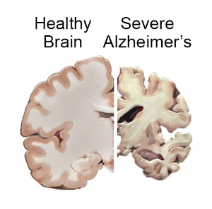
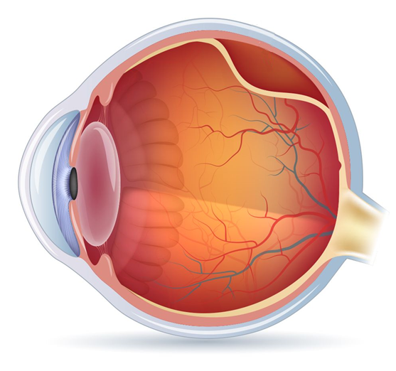
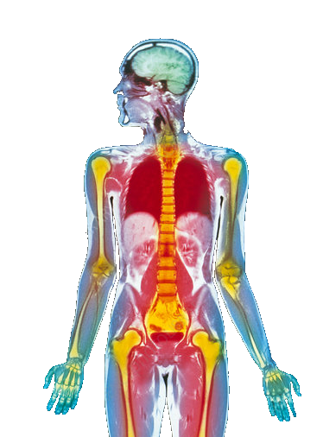
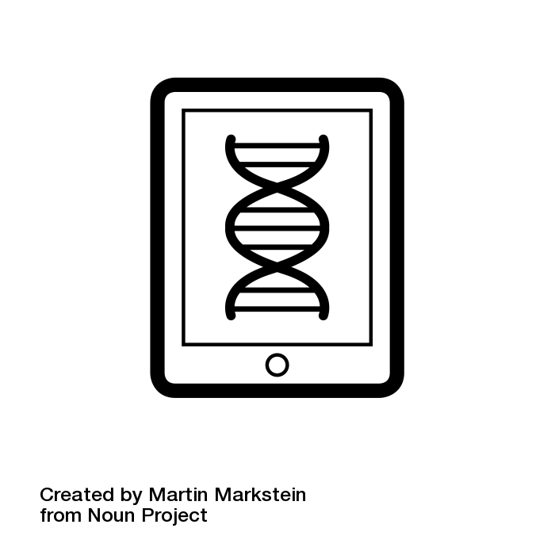
Example of Health/Biomedical Informatics
Healthy brain
demented brain
Retinal detachment fluid build up
Neuroimaging informatics
Retinal imaging informatics
AI-integrated Biomedical Informatics
Precision medicine
Brain-body Integrated Health informatics
Genomics informatics

Slide 4
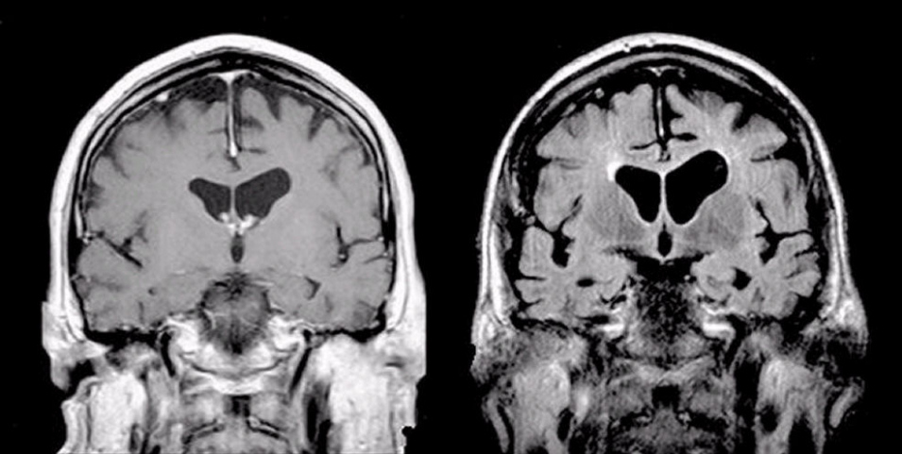
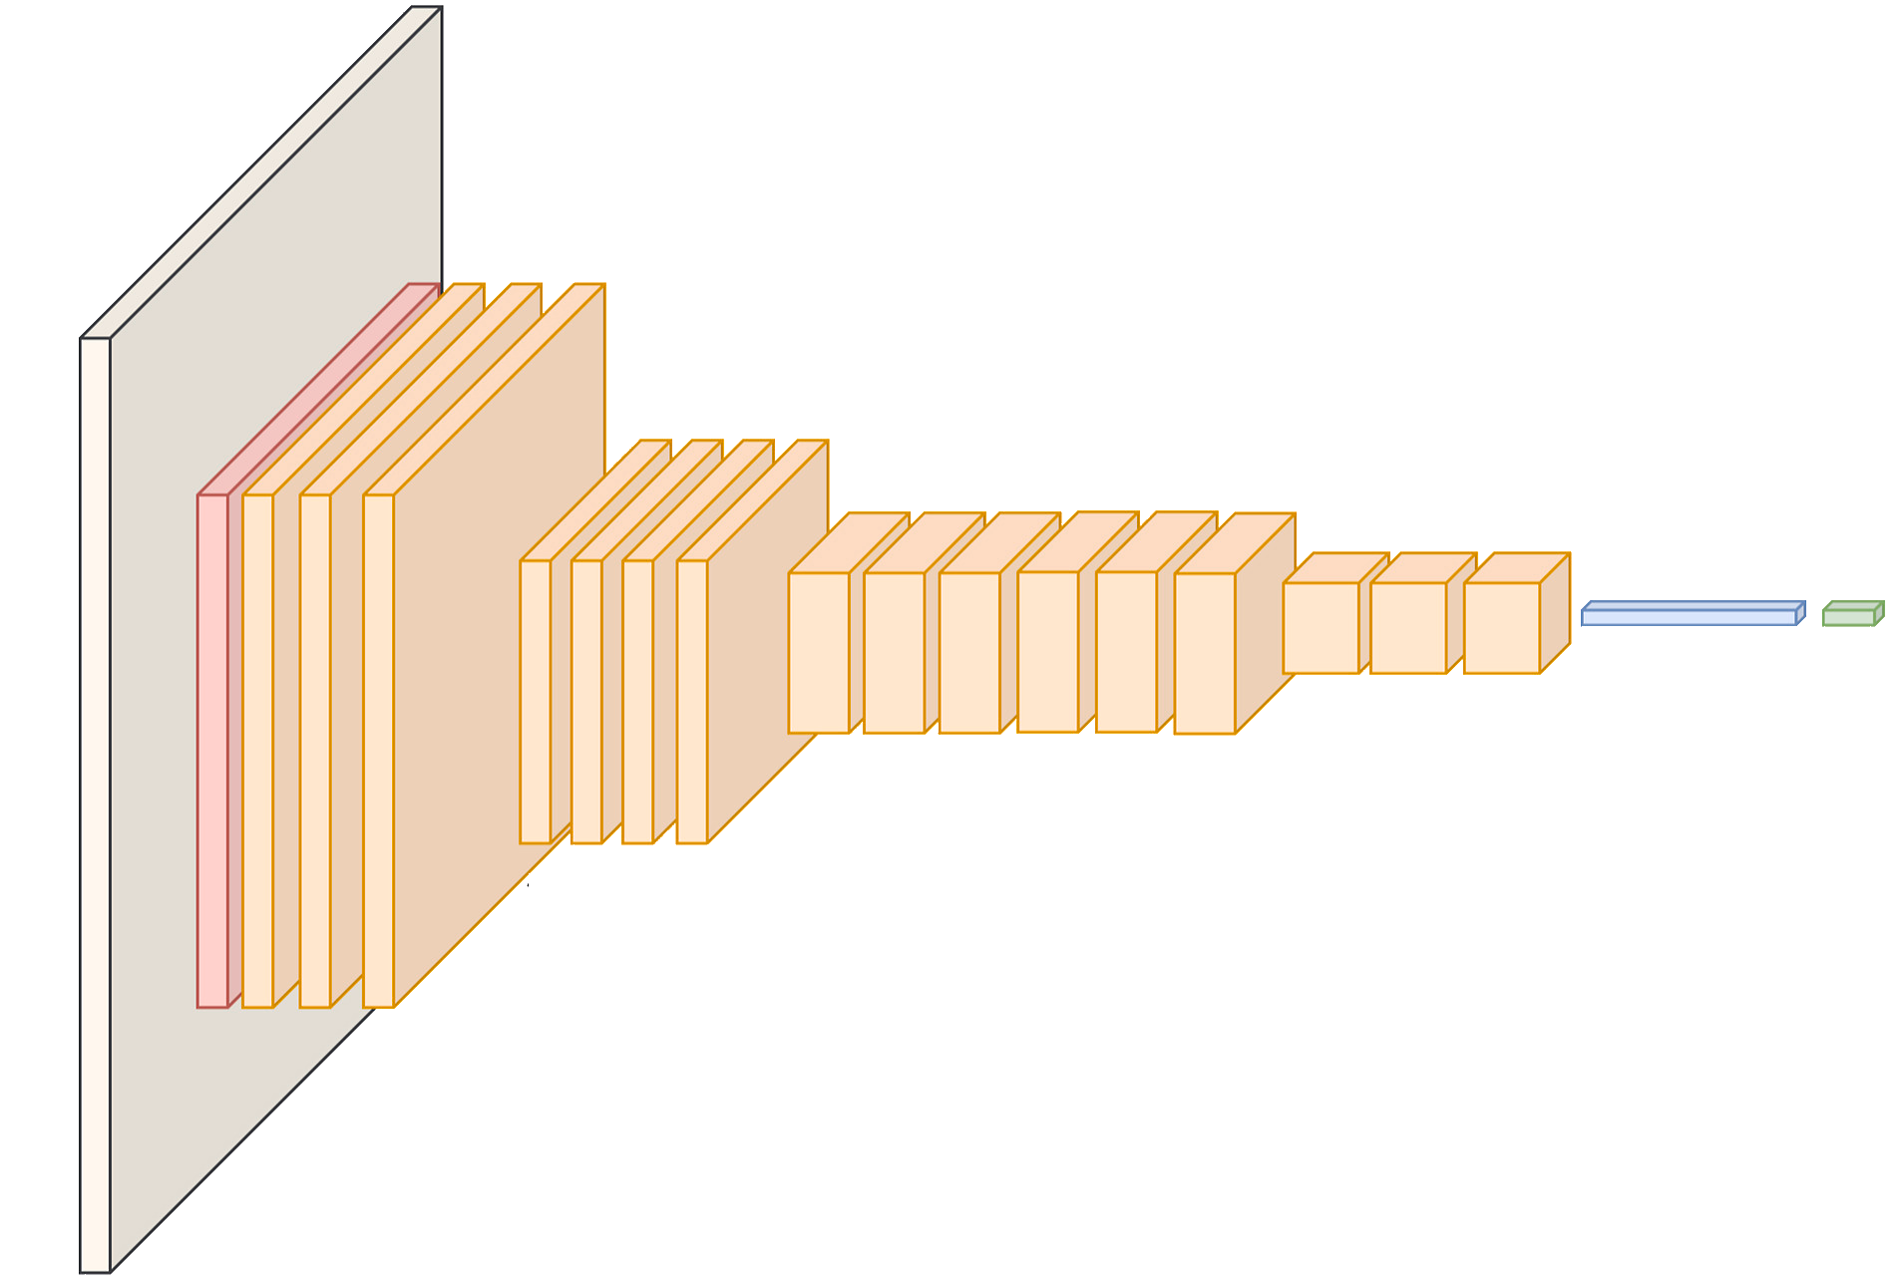
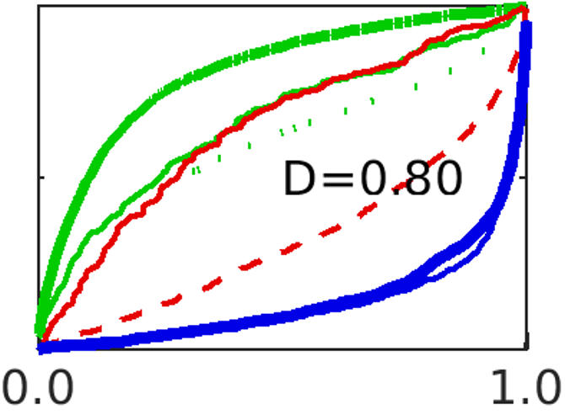
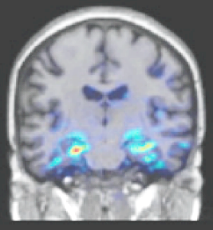
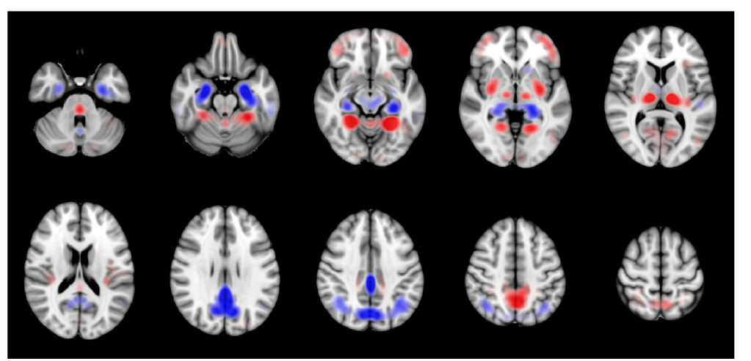
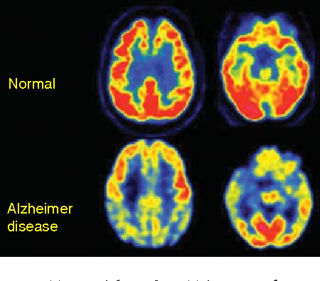
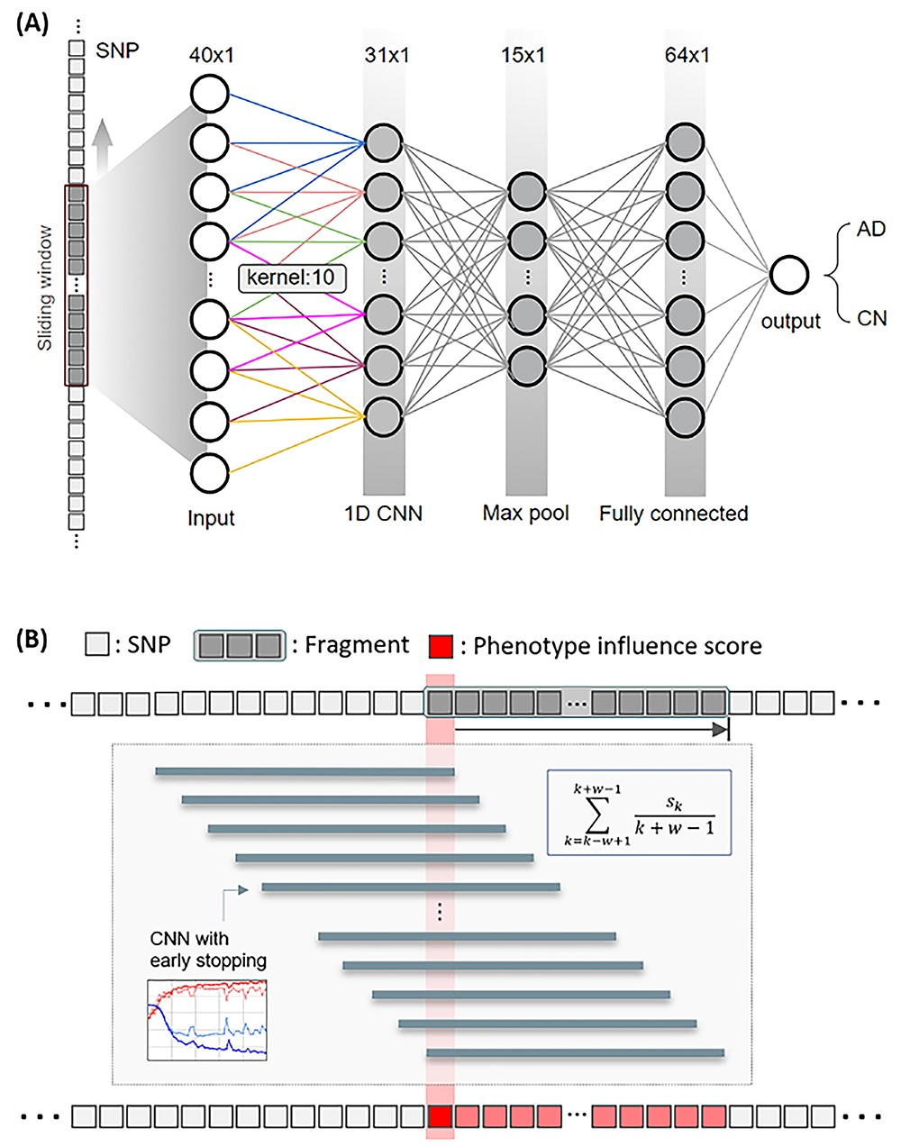
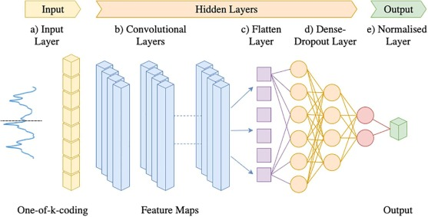
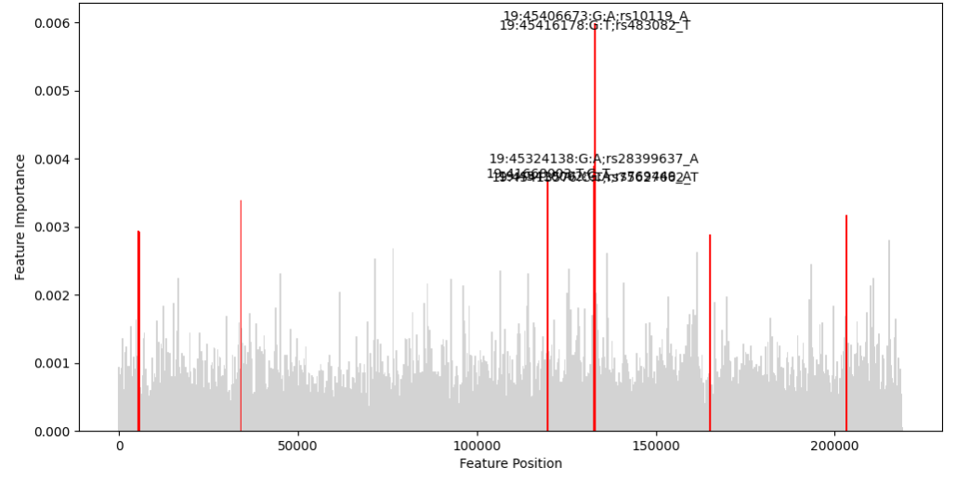
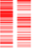
Topic 1: Early prediction, disease risk stratification, biomarker identification
“Multi-modal” neuroimaging dementia risk score
MRI
3D ResNet + Global pooling
Explainable
Saliency-map
Dementia Risk Score
PET
Deep polygenic risk score
Feature selection
1D CNN + Global pooling
Guided-backpropagation-based “Manhattan Plot”
Genomic (SNP)
Preprocessing
TOPMed imputation
Quality Control
SWAT - Sliding-windows Association Test (1D CNN)

Slide 5
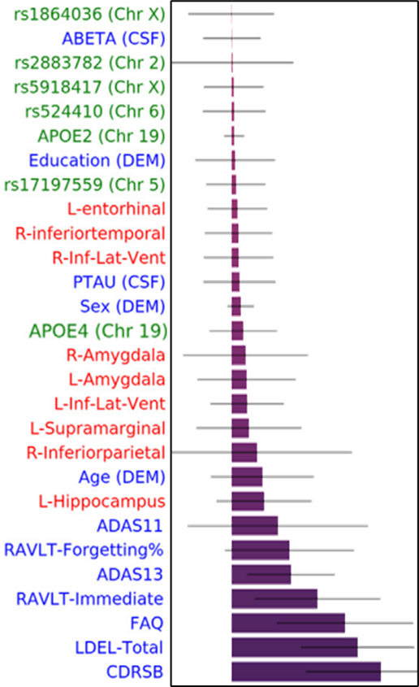
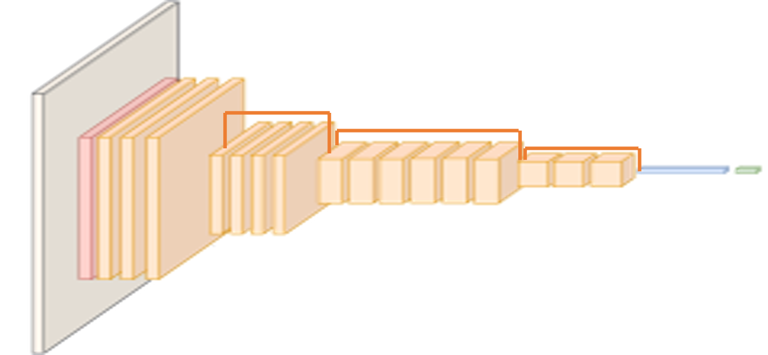
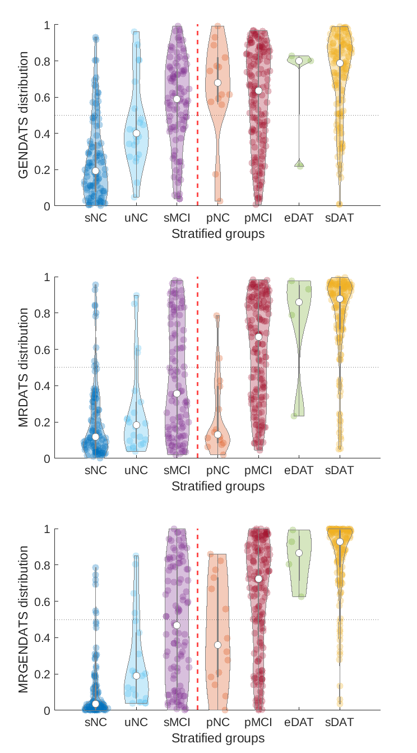
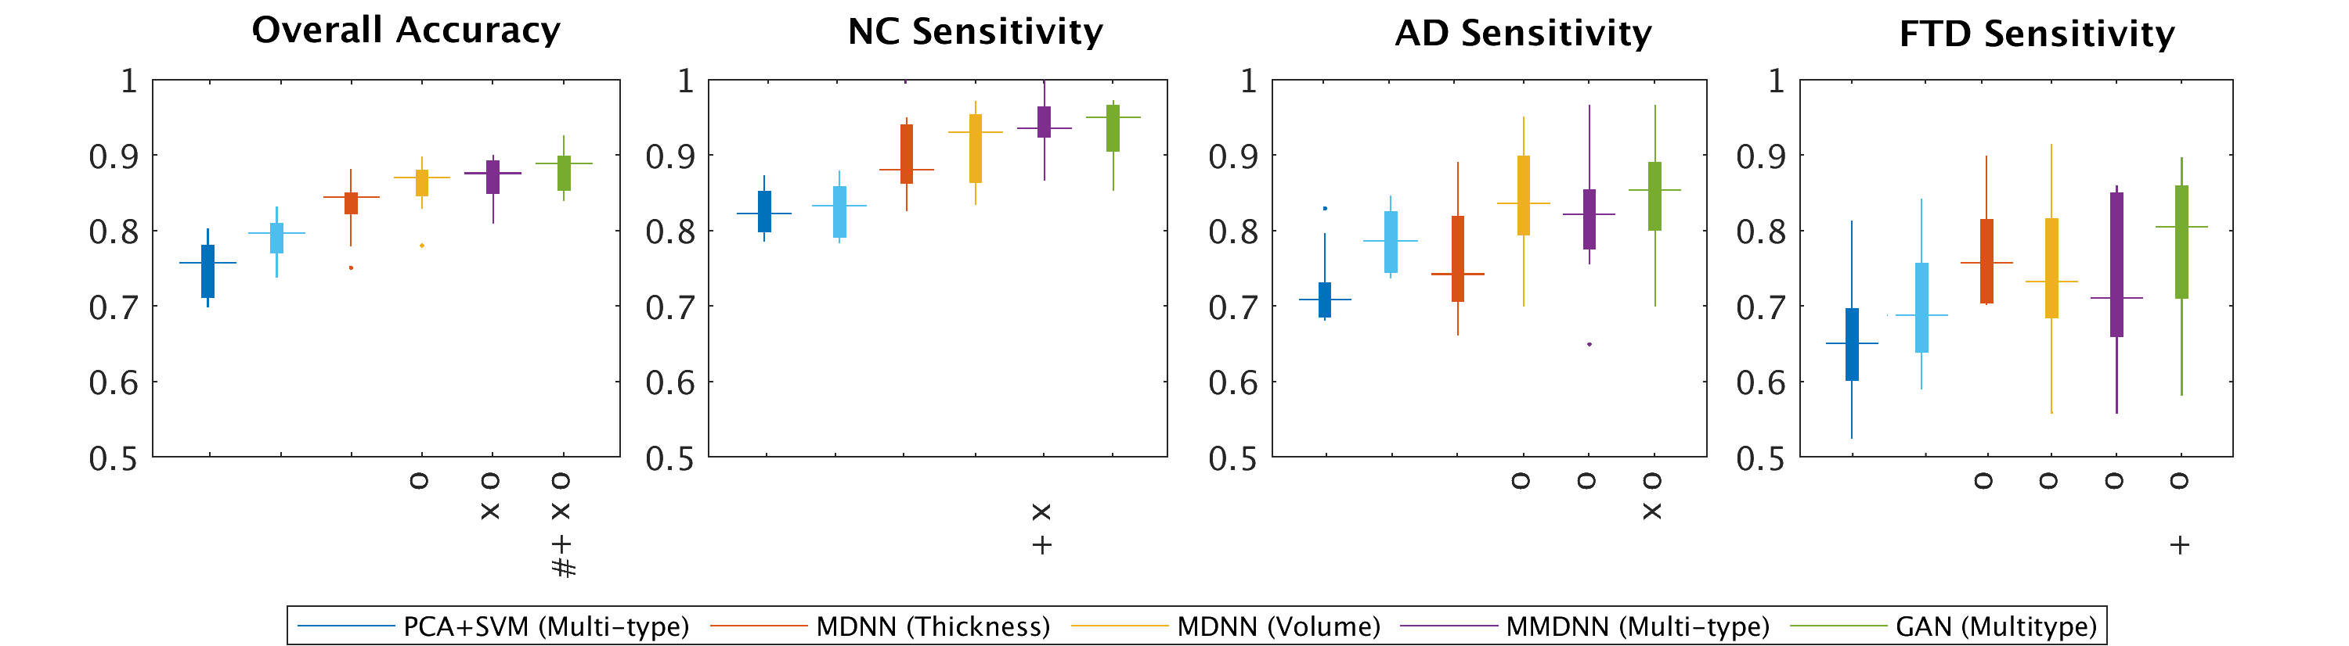
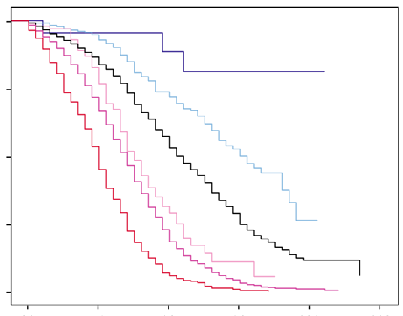

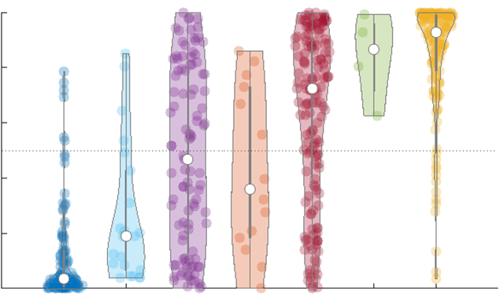
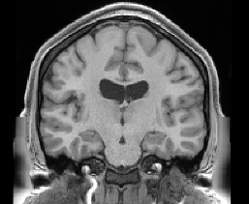
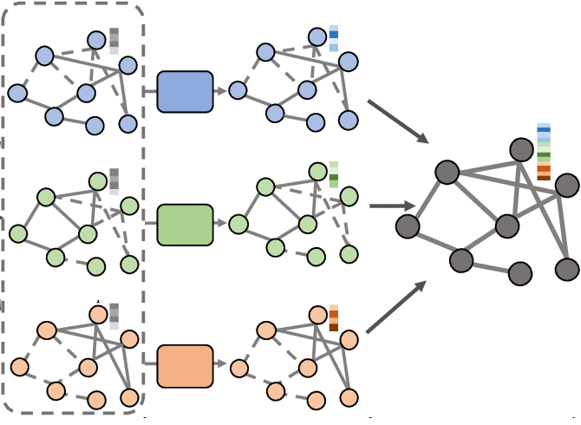
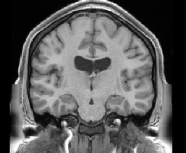
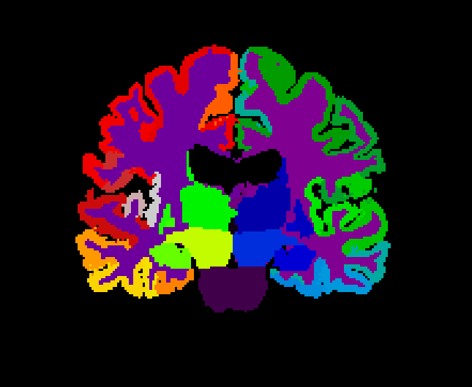
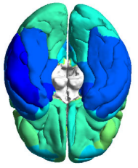
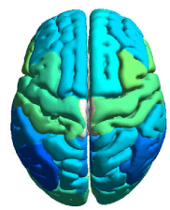
Topic 1: Early prediction, disease risk stratification, biomarker identification
Multi-modal Neuroimaging dementia risk prediction
Stratified dementia risk
Feature Importance
Foundational model
| 3D feature embedding
Dementia risk score | time to conversion
Non-converter
Converter
Multi-modal Neuroimaging
➔
1
MRI
PET
Yee, Ma, et al. JAD 2022
0
Cortical-atrophy-based graph convolutional network (GCN)
Cortical Surface Construction
GCN
Cortical Feature Importance
1
0
Neuroimaging genomics dementia risk prediction
1
Neuroimaging + Genomics
Multi-level Multi-modal feature fusion
+
0
Mirabnahrazam et al. JAD 2022 | NBA 2023

Slide 6
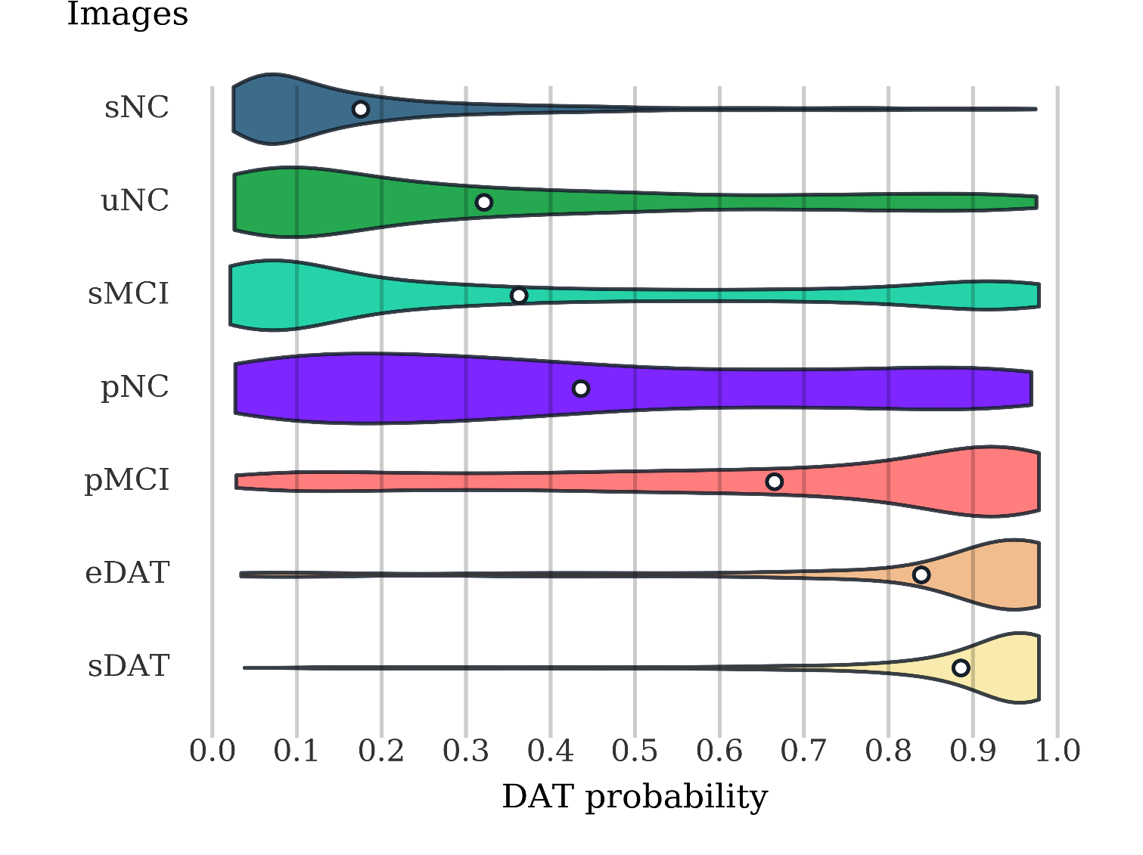
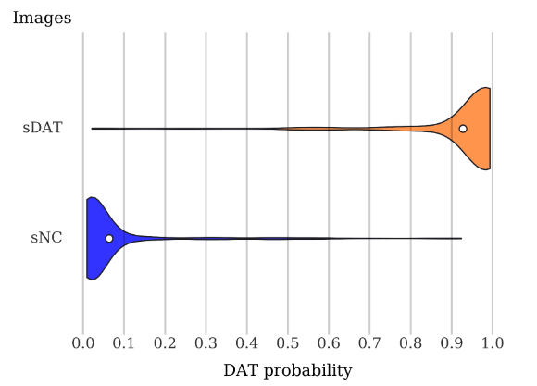
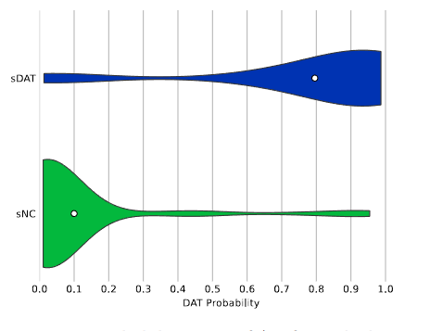
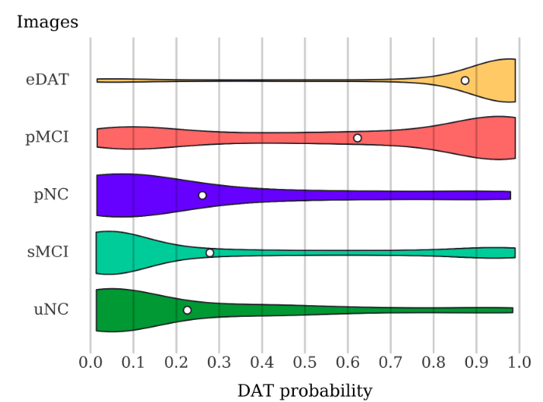
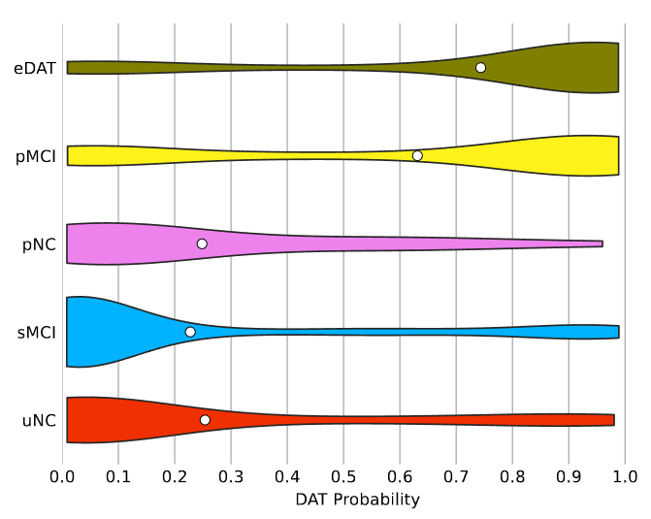
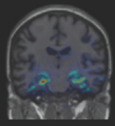
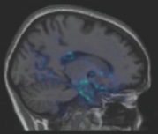
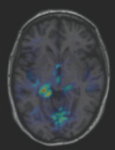
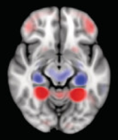
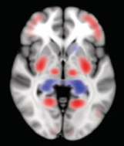
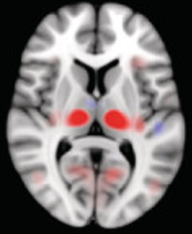
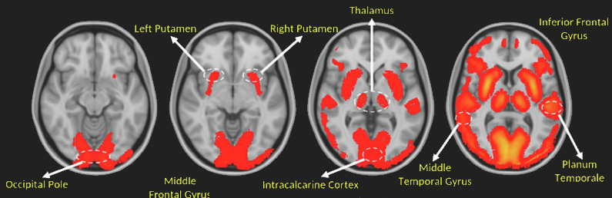
Case 2: Multi-modal Neuroimaging Dementia Risk Stratification
Stratified dementia risk score
Amyloid-PET
MRI
FDG-PET
Stratified groups
Ma, et al. JAD 2021
Cao, Ma, et al. NBD 2023
Edema et al. in prep
Clinical explainability – guided-backpropagation

Slide 7
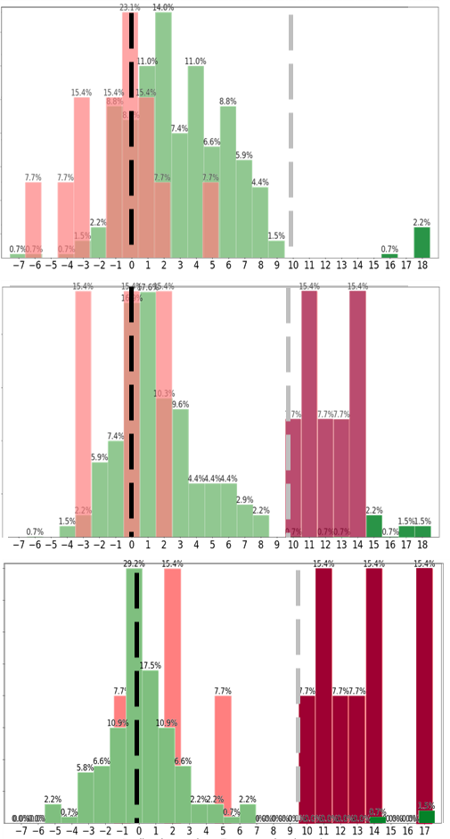

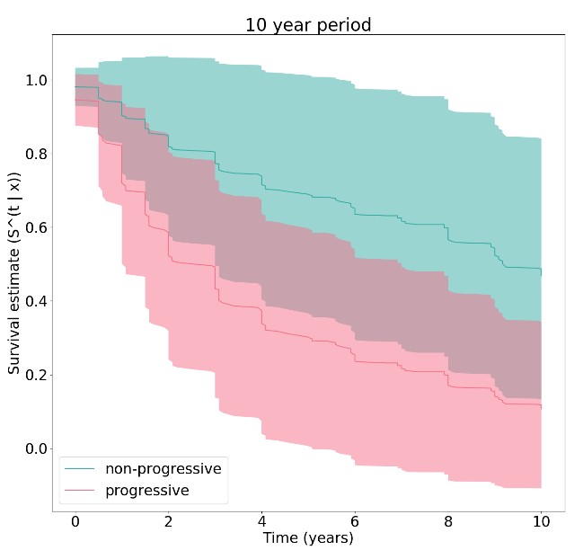
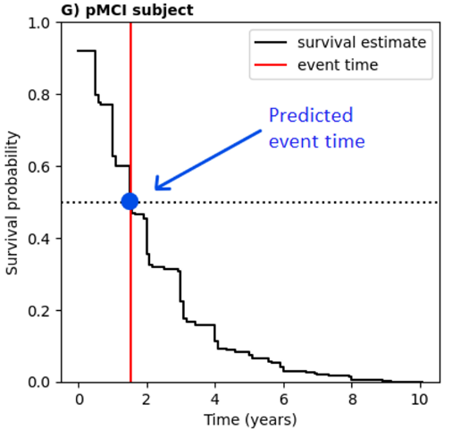
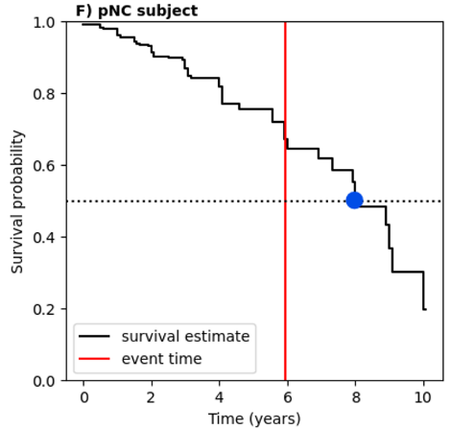
Case 3: Longitudinal disease onset and risk prediction
Predict time-to-disease-onset
Longitudinal stratification of at-risk population - Personalized management - Targeded clinical trial recruitment
NC/MCI
DAT
SNP
NC
MCI
Censored disease onset time
MRI
SNP + MRI
Mirabnahrazam et al. JAD 2022 | NBA 2023

Slide 8
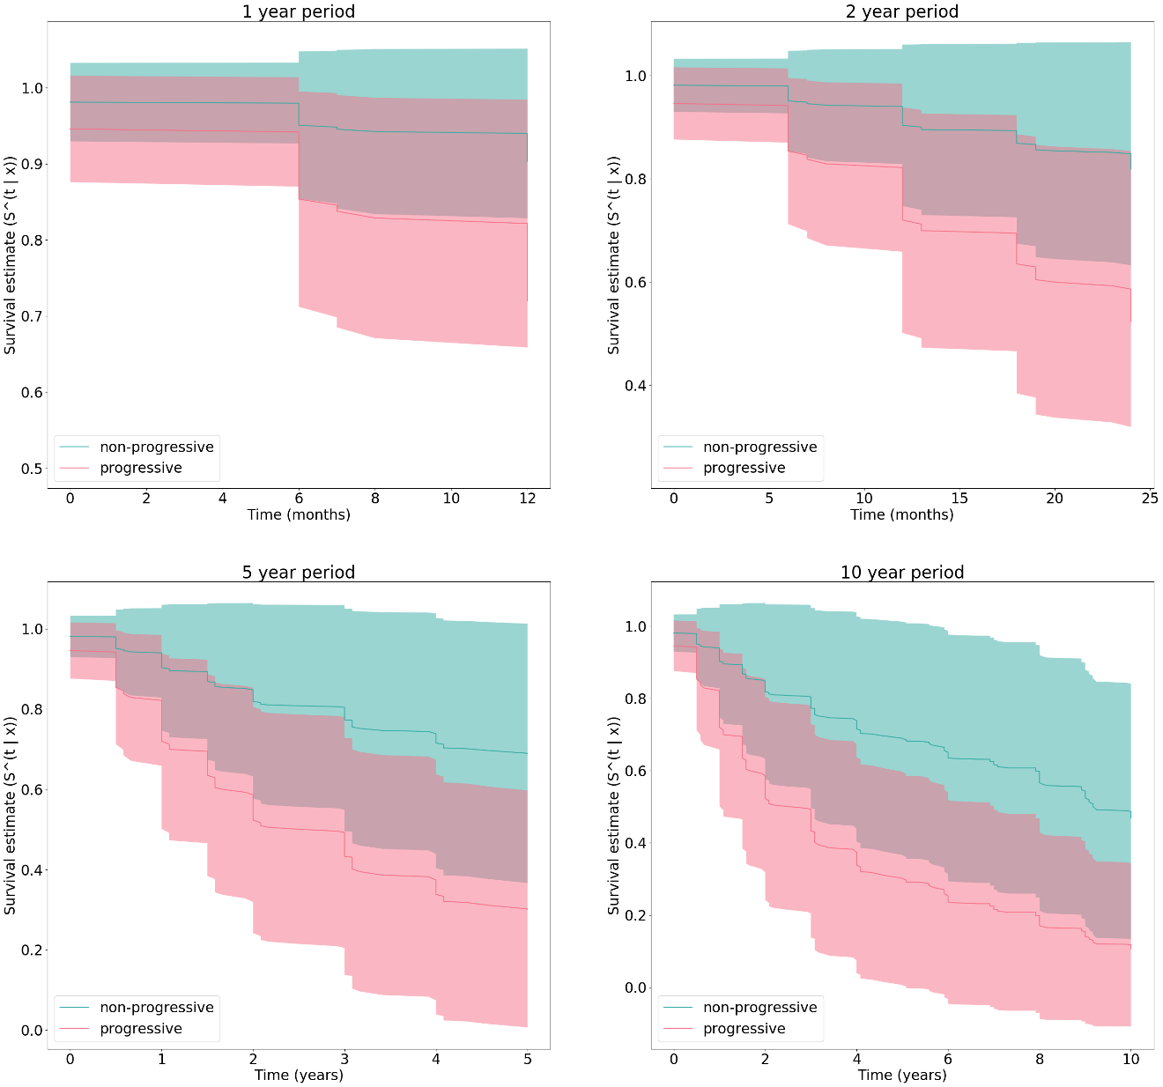
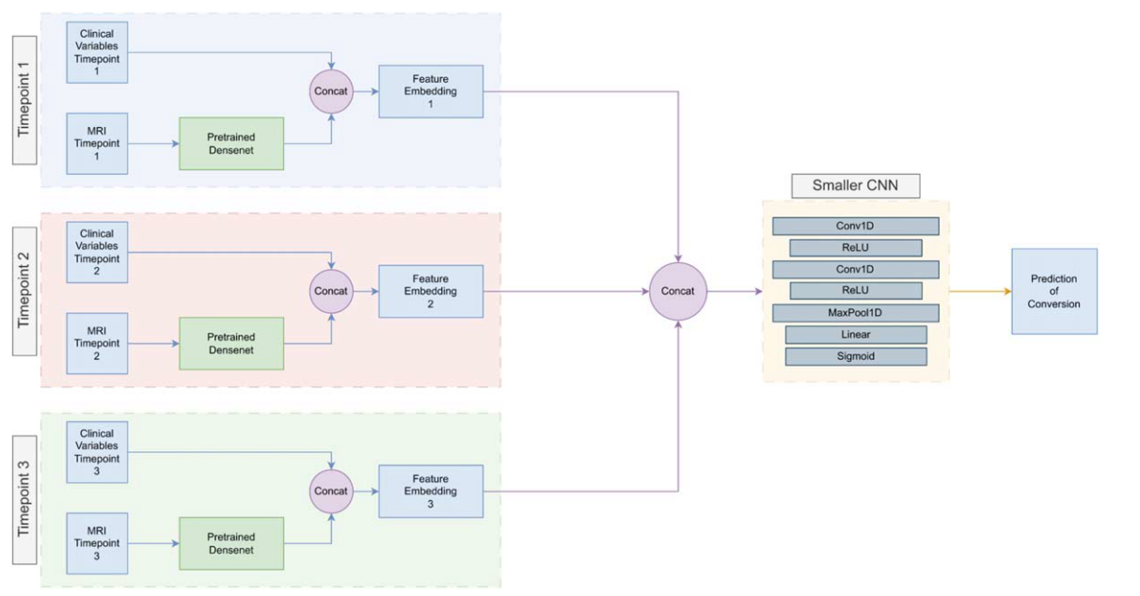
Case 4: Longitudinal Neuroimaging AD Risk Prediction
Predict conversion to dementia in 4-years
Fusion of 3 timepoints neuroimaging data
Cascade network
Combined with non-imaging feature
Longitudinal survival analysis
Fusion of 3-timepoints neuroimaging data
+
+
Kyriacou, etc. In prep
Bapat, Ma, etc. 2024 JAD
C_{idx} | MCI Conversion | AD Conversion
1 TP | 0.603 | 0.756
3 TP | 0.875 | 0.906
AUC | MRI-only | MRI + Clinical
1 TP | 0.708 ± 0.096 | 0.864 ± 0.048
3 TP | 0.751 ± 0.073 | 0.915 ± 0.049

Slide 9
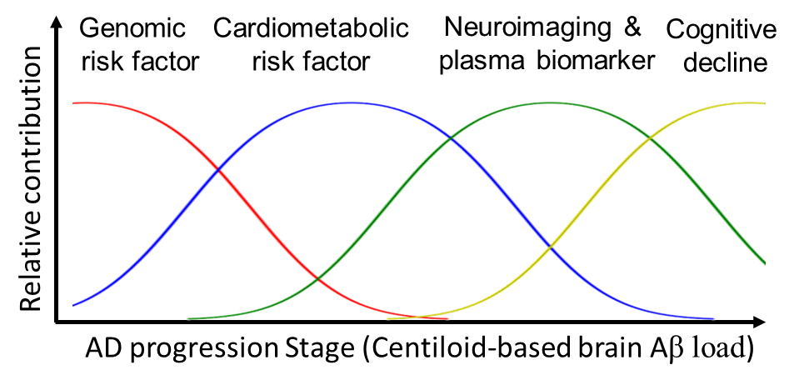
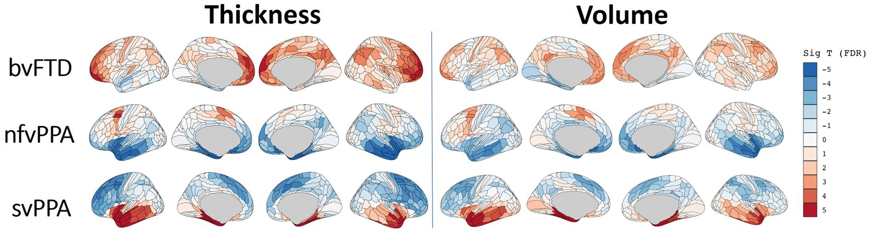
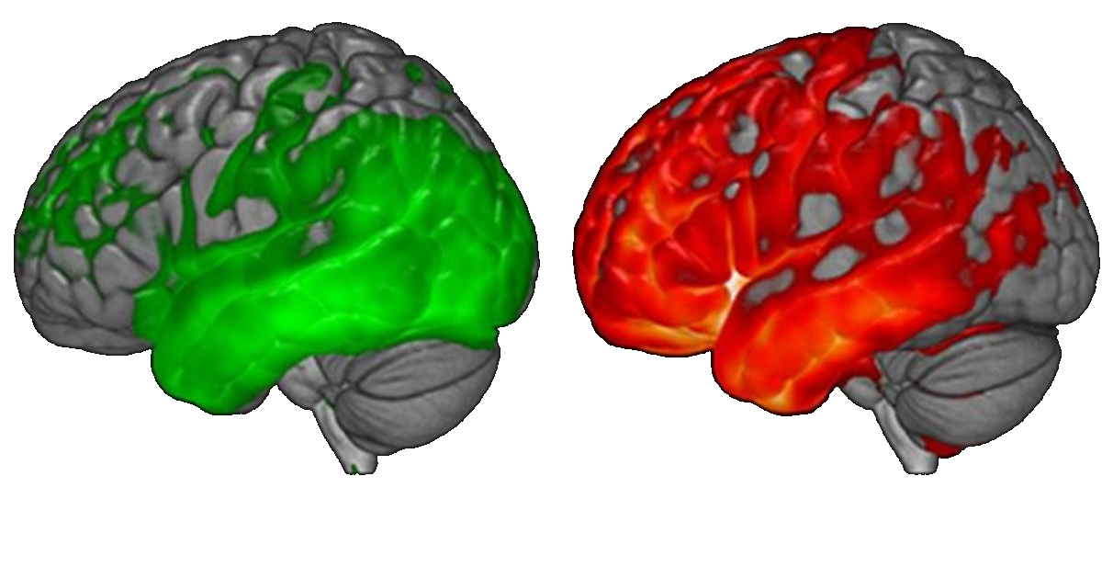
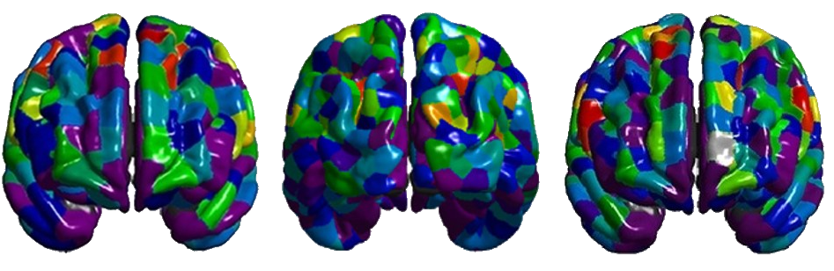
Area 2: Disentangle Disease Heterogeneity
Temporal heterogeneity
Neuroimaging-based deep-learning classification for dementia subtyping
Supervised classification | Unsupervised clustering
Explainable AI dementia subtype neurodegenerative patterns
Multi-level multi-type neuroimaging feature embedding and fusion
Dementia Subtypes
FTD Subtypes
AD Subtypes
Alzheimer Disease (AD)
+
Frontotemporal dementia (FTD)
GAN-based classification loss
Ma D, et al. Front. Neurosci. 2021
Ma D, et al. Front. Neurosci. 2024
Ma D, et al. In prep
Unsupervised learning | Neuroimaging-plasma biomarker | genomics + cardiometabolic risk factor

Slide 10
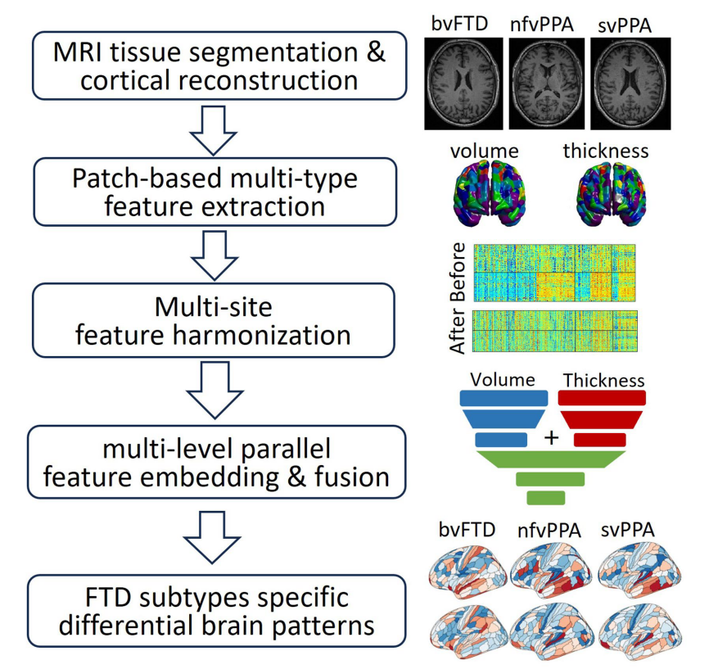
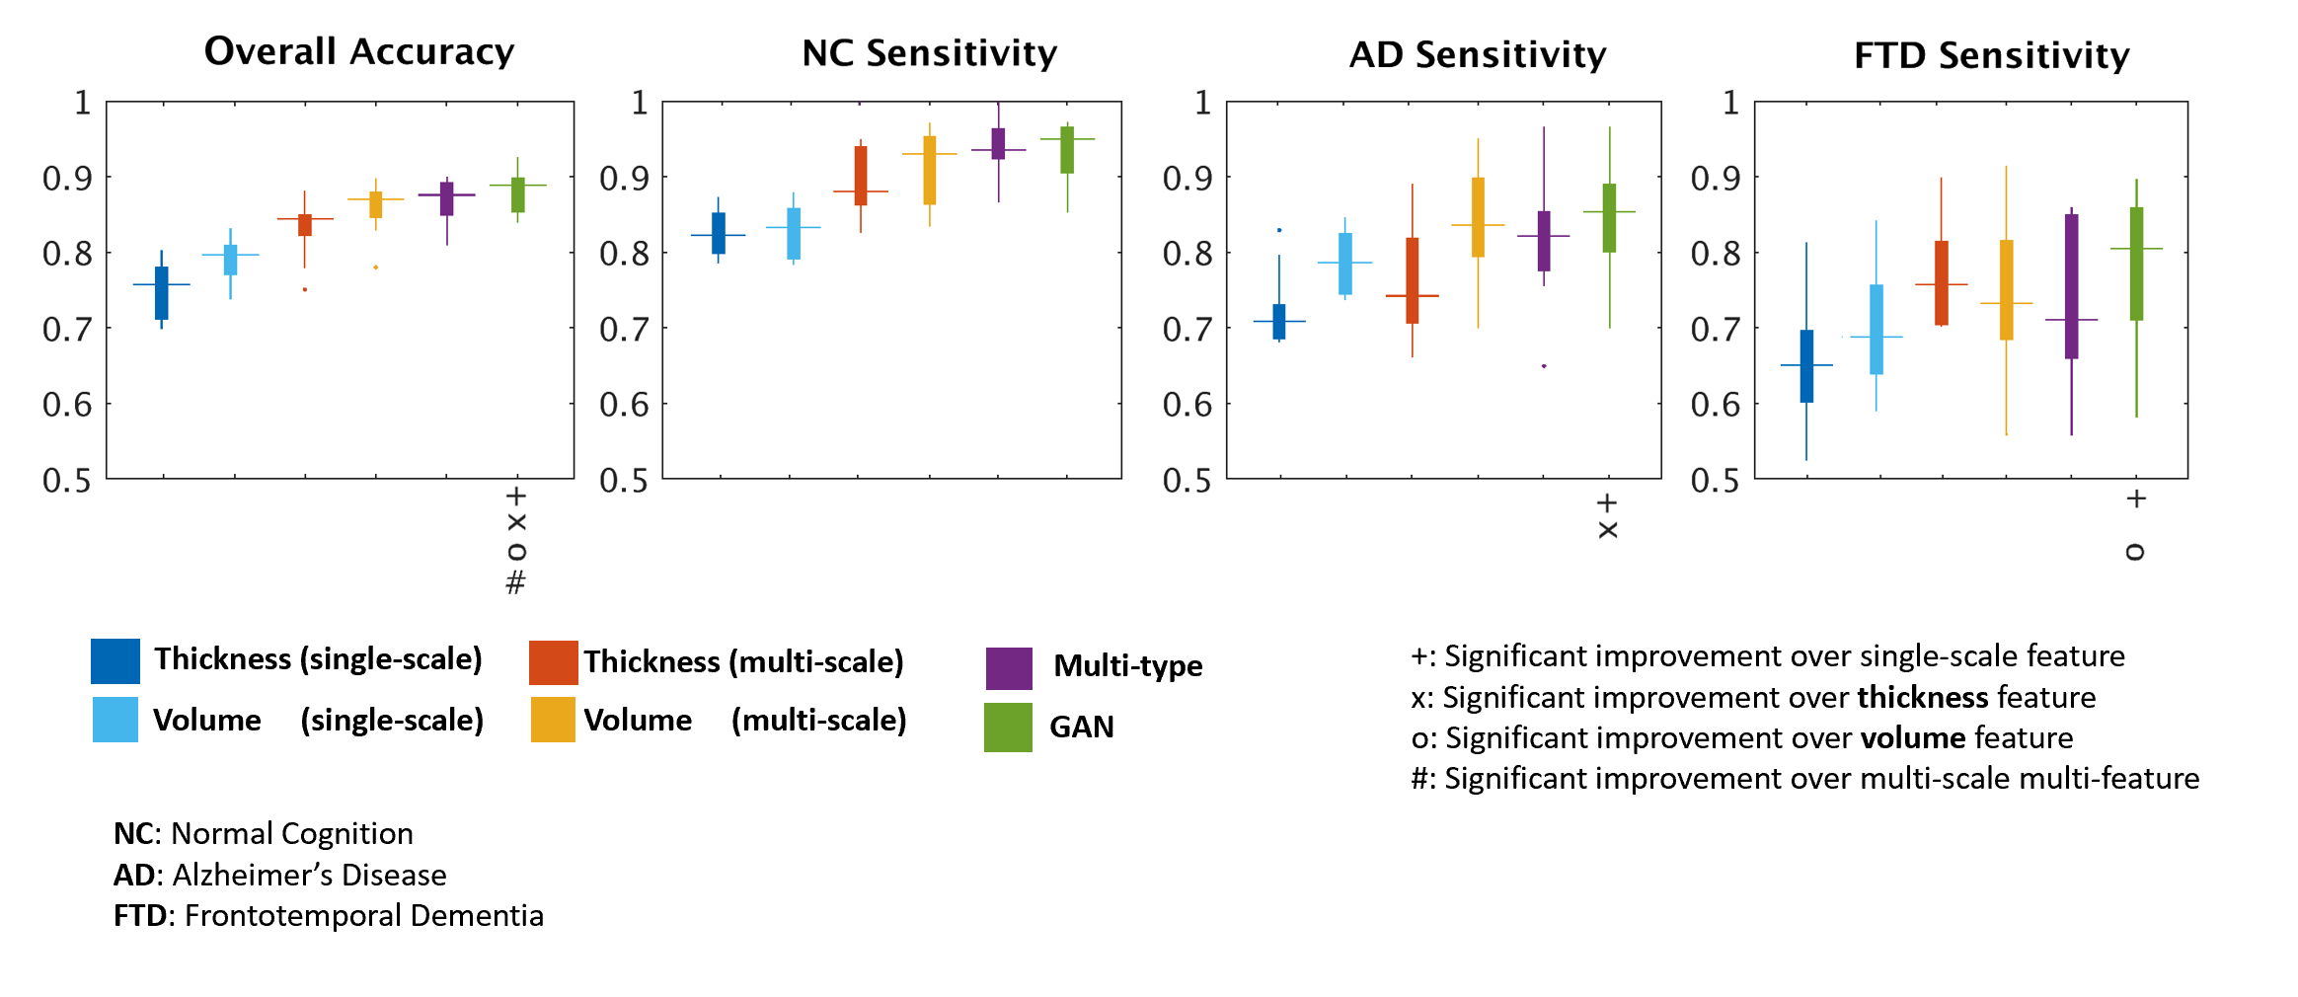
Area 2: Disentangle Disease Heterogeneity
Multi-modal Multi-type Generative Adverserial Netowrk (GAN) based dementia subtyping
NC
Real input feature
Discriminator
(Classifier)
Real classes
AD
noise
Generator
FTD
Fake input feature
Fake class
Ma D, et al. Front. Neurosci. 2021 | 2024

Slide 11






Area 3: Biological Aging | Healthy Aging
Radiological Brain Aging
Epigenomic Aging -- DNA Methylation Clock
Soft-classification-base age prediction ➔ Brain Age Gap (BAG)
Temporal Convolutional Network (TCN): Temporal + dilation blocks
Predicted brain age v.s. chronological age
BAG v.s. CMRF (Cardiometabolic Risk Factors)
Biological v.s. chronological age
Age group clustering
Tavakoli F, Ma D, et al. AAIC 2024
Dip SA, Ma D, et al. 2024

Slide 12



Area 3: Biological Aging | Bias removal
Age-dependent Bias in calculating brain aging
Negative correlation loss penaltilation

Slide 13









Topic 2: Explainable AI for biomedical informatics
Explainability for Neuroimaging – guided-backpropagation | Integrated Gradient
Explainability for Retinal Imaging – 2.5D patch-wise Gradient-weighted Class Activation Mapping (Grad-CAM)
Optical Coherence Tomography (OCT)
Saliency map
PCV
AMD
Clinical interpretability
indocyanine green angiography (ICGA)
Differential diagnosis
Ma D, et al. 2020 Invest Ophthalmol Vis Sci (ARVO)

Slide 14


Topic 2 - Clinical Explainable Differential Diagnosis
AMD
PCV
Ma D, et al. 2020 Invest Ophthalmol Vis Sci (ARVO)

Slide 15




Topic 4: Explainable AI for biomedical informatics
DNN architecture: LF-UNet
Ma D, et al.Acta Neuropathol. Commun 2024

Slide 16

Topic 5: Bias control, domain adaptation, data harmonization
Effective feature harmonization is crucial for control population bias and ensure fairness AI
Ma D, et al. Hum. Brain Mapp. 2019

Slide 17



Topic 5: Bias control, domain adaptation, data harmonization
Case 2: AI-based “Domain adaptation” to control out-of-distribution population bias
Generative-AI (GAN)-based “domain” adaptation
Chen S, Ma D, et al. Comput. Biol. Med 2023

Slide 18
Move on to hands-on tutorial

